Slide 1
Pediatric PACU Pitfalls
Brian Frugoni, MD

Slide 2
Items for discussion
Define Emergence Delirium (ED)
Identify risk factors for ED
Review current prevention and treatment recommendations
Discuss PONV in pediatric patients
List pharmacologic prophylaxis and treatment options

Slide 3
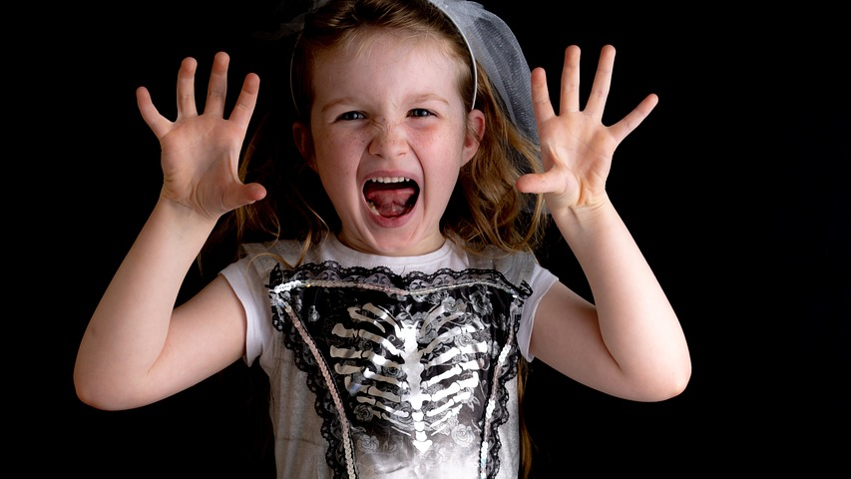

Slide 4
What is Emergence Delirium
Emergence Delirium (ED)
“A dissociated state of consciousness in which the child is irritable, uncompromising, uncooperative, incoherent, and inconsolably crying, moaning, kicking, or thrashing”
Emergence Agitation
An umbrella term containing ED, pain, and other factors

Slide 5
Definition
Inconsolable
Restless
Lack of eye contact
Disoriented
Pulling lines/getting out of bed
Notes:
Pulling lines is more of a byproduct than a primary symptom, but it causes major problems nonetheless

Slide 6
History
Early 1960s – Symptoms of post operative delirium associated with young age, scopolamine premed, cyclopropane/ether, post op pain
Early 1990s – Sevoflurane introduced in Japan, higher incidence of post op agitation compared to halothane
Mid 1990s – Sevoflurane in US, further reports of post operative agitation
Notes:
1960 – Smessaert and 1961 – Eckenhoff described emergence excitement after review of 14,436 prospectively collected records, describing risk factors
1995 – sevo approved in US
1996 – Welborn and Lerman in US report emergence agitation with sevo in US

Slide 7
Clincal Presentation
Development of agitation within 30 minutes of end of anesthetic, lasting from 15 min to several hours (occasionally longer)
Incidence given as 5-80% depending on the study
  Studies over a wide range of years with varying anesthetic technique and definitions of delirium
  Actual incidence likely 20-40%
Notes:
2002 – prospective trial of children 10mo to 6 years fround 30% incidence of inconsolable crying or restlessness
2003 – Voepel-Lewis reported 18% incidence of EA in children 3-7 years old, lasting 14 min to 45 min. Half required pharmacologic intervention
The original incidence of 20% of children comes from Smesseart 1960 paper which looked at 10yrs old and above
More recent metaanalysis of multiple studies of Sevo vs halothane by Kurutani et al in 2008 showed an overall rate of 26% ED with sevo

Slide 8
Causes of harm
Risk of self injury
Parental distress
PACU discharge delay
Delayed postoperative behavior disturbances
Notes:
Post op behavior disturbances include sleep disturbance, bed wetting, temper tantrums, attention seeking. Children with ED more likely to have ongoing changes one week after surgery by survey of 100 children (Kim et al). Premedication, age, pain, and type of surgery were not predictive of these behavior changes

Slide 9
Risk Factors
Patient Factors
Surgical/Anesthetic Factors
Preschool age
Child temperament?
Parental anxiety?
Preoperative anxiety?
Otolaryngologic surgery
Ophthalmologic surgery
Volatile anesthetic
Postoperative pain

Slide 10
Risk Factors – volatile anesthetic
Volatile anesthetics significantly more likely than intravenous agents to cause ED
Desflurane = Sevoflurane = Isoflurane > Halothane
Less soluble agents with higher incidence
Rapid vs slower emergence from sevoflurane does not appear to show a difference
Notes:
Studies of abrupt discontinuation of sevo vs gradual titration off has showed no difference. There is also significantly less ED with propofol than sevo despite both agents coming off quickly

Slide 11
Risk Factors – volatile anesthetic
Relative risk of EA vs Sevoflurane
Halothane RR 0.51 (0.41-0.63)
Isoflurane RR 0.76 (0.46-1.23)
Desflurane RR 1.46 (0.92-2.31)
Notes:
Since sevoflurane first introduced, it was found to have a higher risk of EA than halothane. Postulated mechanism include rapid offset of the less soluble agents.
A Cochrane review by Costi comparing sevo to other volatile anesthetics, and comparing effectiveness of EA prophylaxis, was published in 2014
Looked at 158 studies including 14,045 children. There were 69 studies comparing sevo to other volatile agents and 100 looking at adjucts to sevo
There were 6 studies on isoflurane vs sevoflurane showing variable results. 2 examples
Bortone in 2006 showed 28/54 (52%) in the sevo group vs 18/56 (32%) in the iso group having EA. Done in subumbilical surgery with a caudal block
Meyer in 2007 also in subumbilical surgery with a caudal block. 9/30 (30%) EA in sevo group and 10/29 (34%) in iso group with EA
Taken as a whole, analysis of the 6 studies showed a trend towards less agitation with iso but with a CI that crosses 1. Make of that what you will

Slide 12
Risk factors – type of surgery
Surgical pain may increase risk
Ear, nose, throat and eye surgery are all independent risk factors
ED can and does occur in non-painful anesthetics, so pain clearly not whole story
MRI study – ED with sevoflurane 30% vs halothane 0%
Notes:
Cravero in 2000 showed emergence agitation in patients undergoing MRI with sevo (30%) vs halothane (0%), when there clearly was not any post op or intraop pain

Slide 13
Behavioral risk?
Conflicting studies on risk of ED in patients with preoperative behavioral issues/anxiety
  Retrospective study of 800 patients showed correlation between higher preop anxiety and ED
  Two other more recent studies showed no difference in ED with preop anxiety
Notes:
Kain et al in 2004 showed risk of ED increased by 10% for every 10 point increment in the childs preoperative anxiety score state as measured by the Yale Preoperative anxiety scale
Berghmans et al 2015 showed no correlation with preop anxiety and ED in 400 children, as measured by the PAED scale
Joo et al 2014 no correlation in anxiety in 90 patients measured with Yale scale preop and PAED post op

Slide 14
Pathogenesis
Remains poorly understood
Unique EEG characteristics in sevoflurane anesthesia
  differences in frontal lobe alpha and delta activity in children developing ED vs those who don’t
  interictal spike events more common in children who develop ED
However, these findings aren’t seen in with isoflurane and desflurane, and these agents also cause ED
Excitation of the locus coeruleus in animal studies
Notes:
Alpha 2 agonists work at locus coeruleus so may explain their benefit in ED

Slide 15
Diagnosis
Clinical diagnosis of:
Agitated delirium
Hypoactive delirium
Differential diagnosis
Pain – most common
Hypoxia, hypotension, hypercarbia, hypoglycemia
CNS accident/increased ICP
Notes:
Agitated delirium – agitated, incolsolable, squiriming, non purposeful movement, no eye contact
Hypoactive delirium -

Slide 16
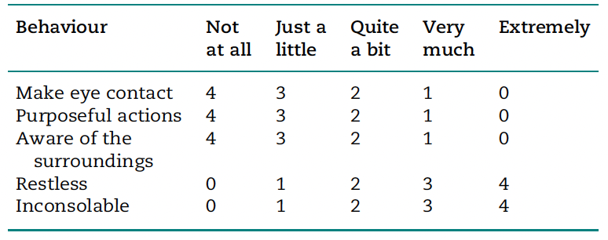
Pediatric Anesthesia Emergence Delirium (PAED) scale
Notes:
PAED has become the accepted standard for measuring likelihood of ED. A score of >=12 has a higher specificity and sensitivity than >= 10. Bajwa et al in 2010 compared several rating scales and found this to be the most useful. A score of < 10 rules out the diagnosis of ED

Slide 17
Prevention
Most straightforward way to avoid ED is to avoid volatile anesthetics
Propofol-based anesthetic RR 0.35 (0.25-0.51) of ED
While less efficacious, several other strategies to prevent ED are beneficial
Risk of ED is not zero with propofol-based anesthetic
Notes:
Of course, avoiding volatile anesthetics creates problems of its own

Slide 18
Preoperative anxiety modification
Decreasing anxiety after surgery via parental presence at induction or video distraction may decreased rates of ED
No convincing evidence that pharmacologic premedication alters rate of ED
Intensive family-centered induction education decreased preop anxiety and decreased ED (10%) vs control (24%), premed (21%), and parental induction (16%) groups in one study

Slide 19
Prevention
Propofol – 1 mg/kg bolus at end of procedure
Midazolam – 0.03 mg/kg at end of procedure
Fentanyl - 0.5-1 mcg/kg at end of anesthetic (RR 0.37)
Ketamine – 0.25 mg/kg at end of procedure
Dexmedetomidine – 0.3-1 mcg/kg (RR 0.37)
Clonidine – 2 mcg/kg (RR 0.45)
Gabapentin – 5 mg/kg
Notes:
Propofol – a dose of 1mg/kg at end of case or 3mg/kg over 3 min was shown to attenuate ED in pain-free surgery or cases where pain control also given
Midazolam – inconsistent results in trials, some show benefit others don’t. Preop doesn’t help.
Fentanyl 0.5-1mcg/kg showed in Cochrane analysis to decrease ED with a RR of 0.37
Dexmedetomidine is effective but prolongs PACU stays. A metaanalysis of dexmedetomidine vs other preventative agents in eye surgery showed dex is superior at preventing ED in those cases (Tan et al 2019)
Gabapentin in 1 study decreased incidence and severity of ED by 20%

Slide 20
Treatment
ED is a self-limited problem and will resolve usually within 45 min – 1 hour
If the patient is safe, no treatment is required
If there is a threat to patient or caregiver safety, pharmacologic treatment can temporize until the problem resolves
Consider differential diagnosis and look for any dangerous causes
Notes:
Parents can be included in the decision making process. Choice can be given in safe situations to wait it out vs sedate and prolong hospital stay

Slide 21
Treatment
Non-pharmacologic options
  Parental presence (most beneficial in agitation > delirium)
  Surgery-specific preparation
  Preoperative eyepatch
  Preop OR visit/Preoperative anxiety control and education
  Avoidance of prolonged fasting
Notes:
Lin et al 2018 – wearing an eyepatch on the operative eye reduced post op ED (16% vs 44%) for cataract surgery
Khanna 2018 – duration of preop fasting was correlated with increased risk of ED

Slide 22
Treatment
Sedative medications to allow ED time to clear
Dexmedetomidine 0.5 - 1 mcg/kg
Fentanyl 0.5 – 1 mcg/kg
Propofol 1 mg/kg
Midazolam
Notes:
Recent study Han 2022 showed a single bolus of dex 0.5mcg/kg was more efficacious than propofol in treatrment of ED. Specifiically, the PAED score dropped to < 10 in 100% of patients who received dex, vs 70% of patients who received propofol
Fentanyl useful to treat any untreated pain causing agitation
A 2016 survey showed that dex was the least used agent
Of course I don’t need to expound to this audience about the safety profile of dexmedetomidine. Limited hemodynamic effect (some hypotension and bradycardia), no respiratory effect. The main issue is prolonging the PACU stay. Use requires weighing the risk and benefit of allowing the agitation to remain manifest. Staff comfort often requires treating the delirium to make ourselves feel better and allow some increased measure of patient safety to stop them from hitting the rails or hitting the ground.

Slide 23
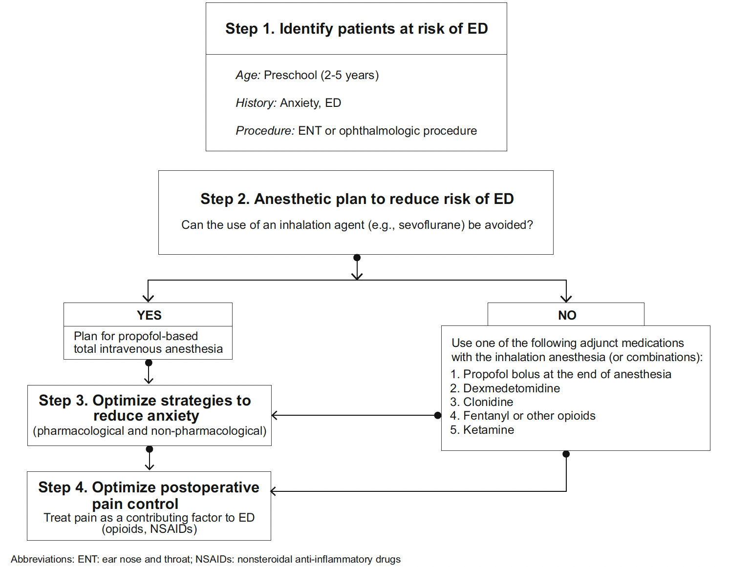

Slide 24


Slide 25
Post-operative Nausea and Vomiting
Major cause of dissatisfaction in anesthesia and surgery
Common problem in pediatrics, 33-82% depending on the study (higher than adults)
Difficulty identifying nausea in non-verbal children likely leads to under-reporting and makes vomiting a more measured endpoint than nausea

Slide 26
Causes of harm
Prolonged PACU stay
Unanticipated hospital admission
Patient/parent dissatisfaction
Wound dehiscence
Aspiration
Dehydration

Slide 27
Identifying PONV
The Pictorial Baxter Retching Faces (BARF) Scale
Children 6 and over have high reliability using scale
Rating of 4 has 80% sensitivity and 85% specificity for desiring antiemetics
Rating of 6 and over, 8/13 patients vomited
Notes:
BARF scale. Script for BARF scale: “Have you thrown up or felt like you were going to throw up before? How did your tummy feel then? We call that feeling of being sick to the stomach nausea. These faces show children who feel no nausea at all, who feel a little bit nauseated, who feel even more nauseated, and these are children who have the most nausea it is possible to feel.” (Point to each face at the appropriate time.) “Which face is more like you feel right now?”

Slide 28
Who is at risk?
Adult risk prediction models don’t apply to young children
Eberhart model:
Age >= 3 years
Duration of surgery > 30 min
Strabismus surgery
History of PONV in patient/parent/sibling
Notes:
Eberhart published a validated model on this in 2004. It looks specifically at postop vomiting, not specifically nausea
4 well defined risk factors

Slide 29
Eberhart Score for POV risk
Risk Factor | Score
Age >= 3 | 1
Duration > 30 min | 1
Strabismus sx | 1
Hx/FHx PONV | 1
 | 0-4
Notes:
For 0-1 risk factors, risk is 9-10%
For 2 – 30%
For 3 – 55%
For 4 – 70%
Does not include tonsillectomy, other scoring systems have included that as a significant risk factor
Model found a sharp increase of PONV risk at 3 years old, with a 0.2-0.8% increased risk per year up to adolescence
No gender difference until adolescence when female gender increases risk

Slide 30
Consensus Guidelines risk update
Preoperative Factors
Intraoperative Factors
Age >= 3 years
History of PONV/motion sickness
Family history of PONV
Post-pubertal female
Strabismus surgery
Adenotonsillectomy
Otoplasty
Duration > 30 min
Volatile anesthetic
Anticholinesterase
No risk factors | Low risk
1-2 risk factors | Medium risk
3 or more risk factors | High risk
Notes:
Most recently update 2020, consensus guidelines for the treatment of PONV in adults and children. They included more risk factors and included recommendations on degree of prophylaxis

Slide 31
Other Anesthesia factors
Opioids – variable but significant contributor to risk
Long-acting opiates increase risk vs fentanyl
NSAIDs - can reduce risk likely by opiate-sparing
remains controversial in tonsillectomy
Acetaminophen – clinically significant reduction in opiates/SE
Notes:
Efune 2018 published on post discharge nausea and vomiting in pediatric patients.
Of 1041 patients who received GA, 143 (14%) had post discharge N/V
No intraop opiate – 8% had post discharge N/V
intraop fentanyl – 14% had post discharge N/V
intraop long acting opiate – 24% had post discharge N/V

Slide 32
Other Anesthesia factors
Nitrous oxide – likely not much effect in short cases
Volatile anesthetic – significant contributor but can be offset by single agent prophylaxis
Neostigmine – limited risk but can be avoided with Sugammadex
Dehydration – 30 ml/kg crystalloid can reduce risk of N/V in same day surgery
Regional anesthesia – great for limiting opiates and reducing amount of volatile anesthetic needed (cadual and TAP blocks studied and reduce post op pain and PONV in children)
Notes:
Caudal and TAP blocks reduced PONV in children undergoing urologic roboic assist lap surgery

Slide 33
Pharmacologic prophylaxis
5 HT3 Antagonists
Ondansetron (0.1-0.15 mg/kg max 4mg)
greater relative risk reduction compared to others
QTc prolongation – caution in congenital long QT
better at preventing vomiting than nausea
reduced clearance in children < 6 months
Notes:
Reduced clearance due to immature P450 enzymes

Slide 34
Pharmacologic prophylaxis
Steroids – dexamethasone 0.1 – 0.15 mg/kg
Lower end of range for straightforward PONV prophy
Some providers give higher doses (0.5mg/kg) for tonsillectomy, may not be better than lower dose
Single dose well tolerated as with adults
Notes:
Hermans et al looked at 147 patients undergoing tonsillectomy, gave placebo, dex 0.15mg/kg, or dex 0.5mg/kg. Better pain control and nausea control in steroid group. No difference in 0.15 vs 0.5

Slide 35
Pharmacologic prophylaxis
NK1 antagonist – aprepitant (1-3 mg/kg)
Limited data in children, approved for oncologic N/V
Initial PK studies identified 40mg as an acceptable prophylactic dose
Study of 31 children at risk for PONV age 4-17
No reported ill effects, 4 patients with POV
Notes:
Kanaparthi in 2019 performed a 1 year trial of aprepitent as prophylaxis in kids, 31 patients in all. Well tolerated.

Slide 36
Pharmacologic prophylaxis
Dopamine antagonists - Droperidol – 10-15 mcg/kg
FDA warning 2001 due to QT prolongation in patients receiving large doses
Therapeutic antiemetic doses of droperidol and ondansetron produce similar QT prolongation and the combination did not have additive effect
Less effective in combo with steroids than ondansetron
Notes:
Droperidol is a butyrophenone and D2 antagonist originally developed as an antipsychotic
2001 black box due to QT prolongationa and torsades. Risk was in people receiving 25mg/day.
Mehta documented that the QT prolongation of droperidol 20mcg/kg vs Zofran 0.1mg/kg were the same.
After tonsillectomy, Flubacher found that dexamethasone 0.25mg/kg plus Zofran was more effective than dexamethasone 0.25mg/kg plus droperidol 10mcg/kg
However, it is one of our few medications in a novel class and is potentially useful for refractory treatment
But, it’s not on Rady formulary currently

Slide 37
Pharmacologic prophylaxis
Metoclopramide – likely not very effective when already using other agents, risk of EPS, avoid < 1 year
Scopolamine patch – not FDA approved, likely somewhat effective but use with caution
Dexmedetomidine – likely somewhat effective as prophylaxis, and opiate sparing
Notes:
Metoclopromide – trial combining with dexamethasone in doses of 0, 10, 25, and 50mg. Only 25mg and 50mg doses reduced PONV at the risk of EPS of 0.8%. EPS risk in children 20x that in adults
Scopolamine – single trial, dose 0.375 or 0.75mg transderm (adult dose 1.5mg transderm). Did reduce risk of ponv but side effects include delirium so use with caution
Amisulpride – selective D2 and D3 antagonist which works on CRTZ to reduce PONV. Drug is not studied in children

Slide 38
Pharmacologic prophylaxis
Gabapentin – decreases tachykinin neurotransmission
Diphenhydramine – some use as rescue agent
Acupuncture of P6 point
Notes:
Gabapentin at a dose of 5mg/kg has in case reports helped with refractory PONV in patients post craniotomy. Not yet well studied

Slide 39
Utility of TIVA vs volatile
Propofol antiemetic properties by infusion are well documented in adults and children
Systematic reviews found TIVA as effective as single agent prophylaxis with volatile anesthetic in baseline risk patients
TIVA for strabismus surgery – higher rate of oculocardiac reflex causing significant bradycardia
Recommendation for TIVA +/- 5HT3 antagonist for high-risk patients
Notes:
TIVA vs des-n20 in one study, <10% rate of PONV, lower post op agitation

Slide 40
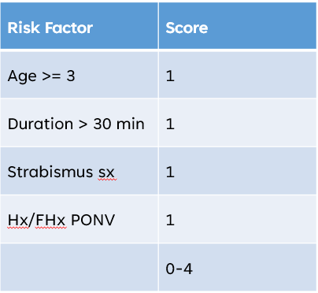
Approach to the patient
Therapy depends on perceived risk of PONV
Consensus guideline recommendations:
Low risk (no risk factors) – no tx vs single agent 5HT3 or steroid
Medium risk (1-2 risk factors) – dexamethasone + 5HT3
High risk (3 or more risk factors) – above plus consider TIVA
Notes:
Guidelines would suggest every patient 3 or over having strabismus surgery have a TIVA, which I’m not sure is always practical. I weight personal history of family hx strongly in the decision

Slide 41
Treatment of PONV
Most literature is aimed at prevention rather than treatment
Second dose of ondansetron in adults is no more effective than placebo
Limited data in children, 5% of this study pop was 12-18
Recommendation for antiemetic class that patient has not yet received
Diphenhydramine
Droperidol
Dexmedetomidine
IV hydration

Slide 42
Treatment of PONV
Because treatment is difficult, optimal prophylaxis is most beneficial
Avoid opiates where possible – multimodal pain treatment
Plan regional anesthesia when able

Slide 43
Take home points
Post-operative complications can have a significant impact on patient and parent comfort and satisfaction
Identify patients at risk for emergence delirium and PONV, emphasize prophylaxis where possible
Sometimes trying to avoid multiple complications can have competing goals

Slide 44
Thank you!

Slide 45
References
Sikich N, Lerman J. Development and psychometric evaluation of the pediatric anesthesia emergence delirium scale. Anesthesiology. 2004 May;100(5):1138-45.
Holzki J, Kretz FJ. Changing aspects of sevoflurane in paediatric anaesthesia: 1975-99. Paediatr Anaesth. 1999;9(4):283-6.
Kim J, Byun SH, Kim JW, Kim JY, Kim YJ, Choi N, Lee BS, Yu S, Kim E. Behavioral changes after hospital discharge in preschool children experiencing emergence delirium after general anesthesia: A prospective observational study. Paediatr Anaesth. 2021 Oct;31(10):1056-1064.
Kim J, Lee HC, Byun SH, Lim H, Lee M, Choung Y, Kim E. Frontal electroencephalogram activity during emergence from general anaesthesia in children with and without emergence delirium. Br J Anaesth. 2021 Jan;126(1):293-303.
Koch, Susanne; Rupp, Leopold; Prager, Christine; Wernecke, Klaus D.; Kramer, Sylvia; Fahlenkamp, Astrid; Spies, Claudia D.. Emergence delirium in children is related to epileptiform discharges during anaesthesia induction: An observational study. European Journal of Anaesthesiology. 2018;35(120:929-936.
Oda Grung Grotmol, Narththahi Nesarajah, Tom Giedsing Hansen. Postoperative emergence delirium in children: a narrative review of recent publications. Signa Vitae. 2021. 17(3);10-20.
Cravero J, Surgenor S, Whalen K. Emergence agitation in paediatric patients after sevoflurane anaesthesia and no surgery: a comparison with halothane. Paediatr Anaesth. 2000;10(4):419-24.
Kain ZN, Caldwell-Andrews AA, Maranets I, McClain B, Gaal D, Mayes LC, Feng R, Zhang H. Preoperative anxiety and emergence delirium and postoperative maladaptive behaviors. Anesth Analg. 2004 Dec;99(6):1648-1654.
Aono J, Mamiya K, Manabe M. Preoperative anxiety is associated with a high incidence of problematic behavior on emergence after halothane anesthesia in boys. Acta Anaesthesiol Scand. 1999 May;43(5):542-4.
Kain ZN, Mayes LC, Caldwell-Andrews AA, Karas DE, McClain BC. Preoperative anxiety, postoperative pain, and behavioral recovery in young children undergoing surgery. Pediatrics. 2006 Aug;118(2):651-8.
Kain ZN, Caldwell-Andrews AA, Maranets I, McClain B, Gaal D, Mayes LC et al. Family-centered preparation for surgery improves perioperative outcomes in children: a randomized controlled trial. Anesthesiololgy. 2007;106:65-74
Costi D, Cyna AM, Ahmed S, Stephens K, Strickland P, Ellwood J, Larsson JN, Chooi C, Burgoyne LL, Middleton P. Effects of sevoflurane versus other general anaesthesia on emergence agitation in children. Cochrane Database Syst Rev. 2014 Sep 12;(9):CD007084.
Aouad MT, Yazbeck-Karam VG, Nasr VG, El-Khatib MF, Kanazi GE, Bleik JH. A single dose of propofol at the end of surgery for the prevention of emergence agitation in children undergoing strabismus surgery during sevoflurane anesthesia. Anesthesiology. 2007 Nov;107(5):733-8.
Eun Jung Cho, Seung Zhoo Yoon, Jang Eun Cho, Hye Won Lee; Comparison of the Effects of 0.03 and 0.05 mg/kg Midazolam with Placebo on Prevention of Emergence Agitation in Children Having Strabismus Surgery. Anesthesiology 2014
Dahmani S, Delivet H, Hilly J. Emergence delirium in children: an update. Curr Opin Anaesthesiol. 2014 Jun;27(3):309-15.
Zhu M, Wang H, Zhu A, Niu K, Wang G. Meta-analysis of dexmedetomidine on emergence agitation and recovery profiles in children after sevoflurane anesthesia: different administration and different dosage. PLoS One. 2015 Apr 13;10(4):e0123728.
Song SY, Kwak SG, Kim E. Effect of a mother's recorded voice on emergence from general anesthesia in pediatric patients: study protocol for a randomized controlled trial. Trials. 2017 Sep 15;18(1):430.
Zhong Q, Qu X, Xu C. Effect of preoperative visiting operation room on emergence agitation in preschool children under sevoflurane anesthesia. Int J Pediatr Otorhinolaryngol. 2018 Jan;104:32-35.
Lin Y, Shen W, Liu Y, Wang Q, Chen Q, Fang Z, Chi W, Gan X, Liu YZ. Visual preconditioning reduces emergence delirium in children undergoing ophthalmic surgery: a randomised controlled trial. Br J Anaesth. 2018 Aug;121(2):476-482.
Khanna P, Saini K, Sinha R, Nisa N, Kumar S, Maitra S. Correlation between duration of preoperative fasting and emergence delirium in pediatric patients undergoing ophthalmic examination under anesthesia: A prospective observational study. Paediatr Anaesth. 2018 Jun;28(6):547-551.
Han X, Sun X, Liu X, Wang Q. Single bolus dexmedetomidine vs propofol for treatment of pediatric emergence delirium following general anesthesia. Paediatr Anaesth. 2022;32(3):446

Slide 46
References (cont)
Tateosian, VS, Champagne K, Gan TJ. What is new in the battle against postoperative nausea and vomiting? Best Pract Res Clin Anaesthesiol. 2018;32(2)137-148
Eberhart LHJ, Geldner G, Kranke P, Morin A, Schauffelen A, Treiber H, Wulf H. Anesth Analg. 2004 99(6)1630-37
Gan TJ et al. Fourth Consensus Guidelines for the Management of Postoperative Nausea and Vomiting. Anesth Analg 2020;131:411-48
Efune PN, Minhajuddin A, Szmuk P. Incidence and factors contributing to postdischarge nausea and vomiting in pediatric ambulatory surgical cases. Pediatr Anes. 2018;28:257-263
Ashok V, Bala I, Bharti N et al. Effects of intraoperative liberal fluid therapy on postoperative nausea and vomiting in children – A randomized controlled trial. Paediatr Anaesth. 2017;27(8)810-15
Watcha MF, Lee A, Medellin E, Felberg MT, Bidani SA. Clinical use of the Pictorial Baxter Retching Faces Scale for the Measurement of Postoperative Nausea in Children. Anesth Analg. 2019;128(6);1249-1255
Hermans V, De Pooter F, De Grotte F, De Hert S, Van der Linden P. Effect of dexamethasone on nausea, vomiting, and pain in paediatric tonsillectomy. Br J Anaesth 2012;109(3)427-31
Salman FT, DiChristina C, Chain A, Afzal AS. Pharmacokinetics and pharmacodynamics of aprepitant for the prevention of postoperative nausea and vomiting in pediatric subjects. J Pediatr Surg. 2018;21:21
Kanaparthi A, Kukura S, Slenkovich N, AlGhamdi F, Shafy SZ, Hakim M et al. Perioperative administration of Emend (aprepitant) at a Tertiary Care Children’s Hospital: a 12-month surgery. Clin Pharmacol. 2019;11:155-60
Mehta D, Sanatani S, Whyte SD. The effects of droperidol and ondansetron on dispersion of myocardial repolarization in children. Paediatr Anaesth. 2010;20(10):905-12
Kovac AL, O’Connor TA, Pearman MH et al. Efficacy of repeat intravenous dosing of ondansetron in controlling post-operative nausea and vomiting: a randomized, double-blind, placebo-controlled multicenter trial. J Clin Anesth 1999;11(6)453-9
Ames WA, Machovec K. An update on the management of PONV in a pediatric patient. Best Pract Res Clin Anaesthesiol. 2020;34:749-58
Kovac AL. Postoperative nausea and vomiting in pediatric patients. Pediatric Drugs. 2021;25:11-37
Bailey CR. Management of outpatient ear nose and throat surgery. Curr Opin Anaesthesiol. 2001;14(6)617-21
Grundman U, Uth M, Eichner A, Wilhelm W, Larsen R. Total intravenous anaesthesia with propofol and remifentanil in paediatric patients: a comparison with desflurane-nitrous oxide inhalation anaesthesia. Aeta Anaesthesiol Scand. 1998;42(7)845-50

